Slide 1

IST 687 Final Project Group 3

Slide 2
Agenda
Recommendations
Data Overview
Predictive Analysis
Inferential Analysis

Slide 3
Recommendations
Focus marketing and operations on attracting business travelers
Minimizing delays should not be a priority
Shift contracts away from low NPS partners to co-located, higher NPS partners by airport

Slide 4
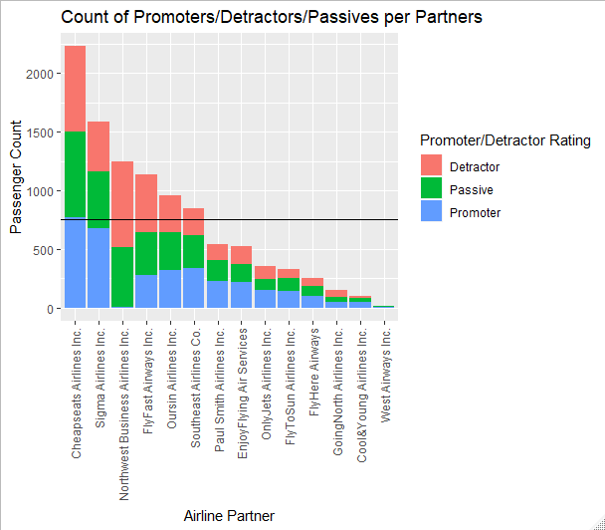
Overview
10,282 Passenger Records
Top 6 Airlines
750 Passenger Threshold
77% of Data

Slide 5
Net Promoter Score
Have you ever wondered why the NPS formula doesn’t include passives? (% of Promoters – % of Detractors)
Detractors speak louder than promoters
Detractors are likely to churn very soon and hence should be prioritized above passive customers
Over passives, detractors are more likely to be your next promoters

Slide 6
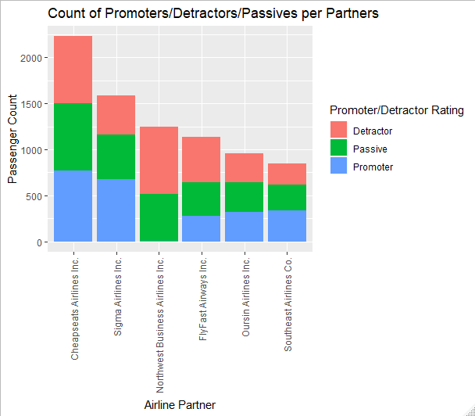
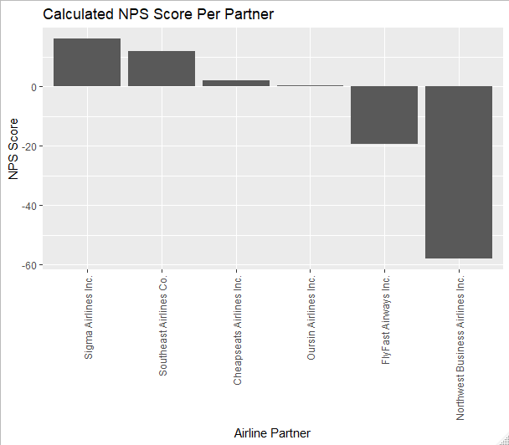
Partner Net Promoter Scores

Slide 7
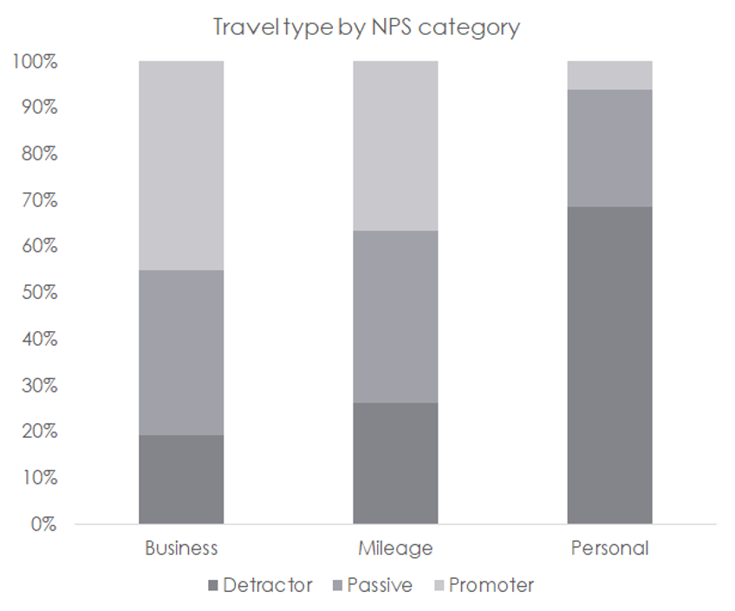
Predictive Analysis: Machine Learning
Business Traveler:
Promoter or Passive
Personal Travel:
Detractor
 | Business Travel |  | Personal Travel
 | Promoter | Passive | Detractor
Top 6 Partners | +12% | +5% | +34%
Northwest Business Airlines | NA | +16% | +32%
FlyFast Airways | +9% | +5% | +35%

Slide 8
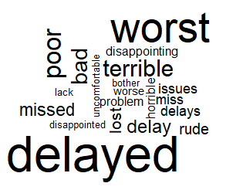
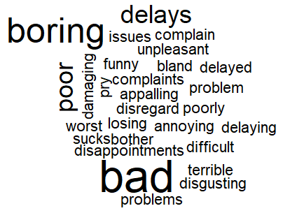
Predictive Analysis: Sentiment Analysis
Delay correlation to Promoter Score
Increase entertainment to reduce detractors among leisure travelers
All Detractors:
Northwest Business Airlines Detractors:

Slide 9
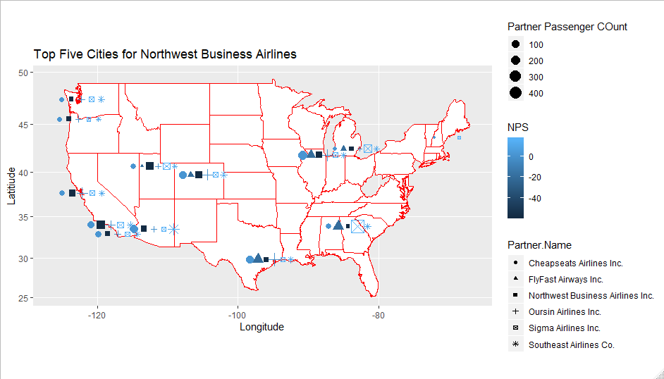
Inferential Analysis
Shift Contracts from Northwest Business Airlines and FlyFast to other Partners at major airports

Slide 10
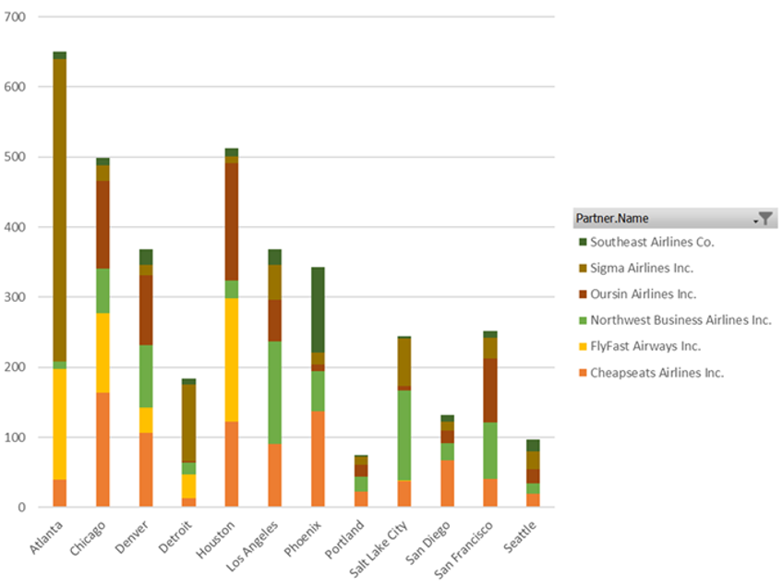
Inferential Analysis
Use chart to identify candidates for contract shifts by airport

Slide 11
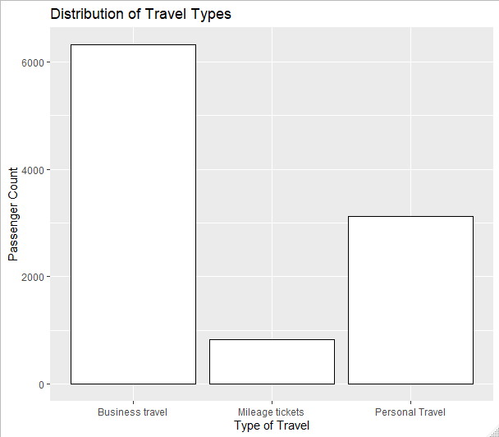
Core Competency

